Slide 1
DATA MINING LECTURE 1
Introduction

Slide 2
What is data mining?
After years of data mining there is still no unique answer to this question.
A tentative definition:
Data mining is the use of efficient techniques for the analysis of very large collections of data and the extraction of useful and possibly unexpected patterns in data.

Slide 3
Why do we need data mining?
Really, really huge amounts of raw data!!
In the digital age, TB of data is generated by the second
Mobile devices, digital photographs, web documents.
Facebook updates, Tweets, Blogs, User-generated content
Transactions, sensor data, surveillance data
Queries, clicks, browsing
Cheap storage has made possible to maintain this data
Need to analyze the raw data to extract knowledge

Slide 4
Why do we need data mining?
Data is power!
Today, the collected data is one of the biggest assets of an online company
Query logs of Google
The friendship and updates of Facebook
Tweets and follows of Twitter
Amazon transactions

Slide 5
The data is also very complex
Multiple types of data: tables, time series, images, graphs, etc
Interconnected data of different types:
From the mobile phone we can collect, location of the user, friendship information, opinions through twitter, images though cameras, queries to search engines

Slide 6
Example: transaction data
Billions of real-life customers:
WALMART: 20M transactions per day
AT&T 300 M calls per day
Credit card companies: billions of transactions per day.

Slide 7
Example: document data
Web as a document repository: estimated 50 billions of web pages
Wikipedia: 4 million articles
Online news portals: steady stream of 100’s of new articles every day
Twitter: ~300 million tweets every day

Slide 8
Example: network data
Web: 50 billion pages linked via hyperlinks
Facebook: 500 million users
Twitter: 300 million users
Instant messenger: ~1billion users

Slide 9
Behavioral data
Mobile phones today record a large amount of information about the user behavior
GPS records position
Camera produces images
Communication via phone and SMS
Text via facebook updates
Amazon collects all the items that you browsed, placed into your basket, read reviews about, purchased.
Google and Bing record all your browsing activity. They also record the queries you asked, the pages you saw and the clicks you did.
Data collected for millions of users on a daily basis

Slide 10
So, what is Data?
Attributes
Collection of data objects and their attributes
An attribute is a property or characteristic of an object
Examples: eye color of a person, temperature, etc.
Attribute is also known as variable, field, characteristic, or feature
A collection of attributes describe an object
Object is also known as record, point, case, sample, entity, or instance
Objects
Size: Number of objects
Dimensionality: Number of attributes
Sparsity: Number of populated
object-attribute pairs

Slide 11
Types of Attributes
There are different types of attributes
Categorical
Examples: eye color, rankings (e.g, good, fair, bad), height in {tall, medium, short}
Nominal (no order or comparison) vs Ordinal (order but not comparable)
Special case: Binary attributes (yes/no, exists/not exists)
Numeric
Examples: dates, temperature, time, length, value, count.
Discrete (counts) vs Continuous (Length)

Slide 12
Numeric Record Data
If data objects have the same fixed set of numeric attributes, then the data objects can be thought of as points in a multi-dimensional space, where each dimension represents a distinct attribute
Such data set can be represented by an n-by-d data matrix, where there are n rows, one for each object, and d columns, one for each attribute

Slide 13
Categorical Data
Data that consists of a collection of records, each of which consists of a fixed set of categorical attributes

Slide 14
Document Data
Each document becomes a `term' vector,
each term is a component (attribute) of the vector,
the value of each component is the number of times the corresponding term occurs in the document.
Bag-of-words representation – no ordering

Slide 15
Transaction Data
Each record (transaction) is a set of items.
A set of items can also be represented as a binary vector, where each attribute is an item.
A document can also be represented as a set of words (no counts)

Slide 16
Ordered Data
Genomic sequence data
Data is a long ordered string

Slide 17
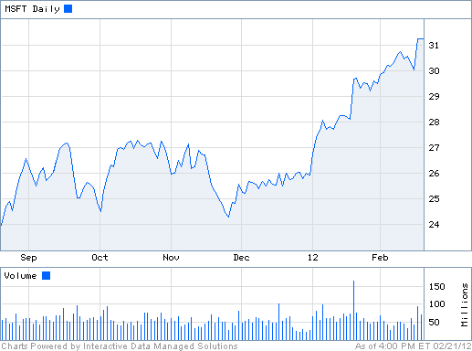
Ordered Data
Time series
Sequence of ordered (over “time”) numeric values.

Slide 18
Graph Data
Examples: Web graph and HTML Links

Slide 19
What can you do with the data?
Suppose that you are the owner of a supermarket and you have collected billions of market basket data. What information would you extract from it and how would you use it?
What if this was an online store?
Product placement
Catalog creation
Recommendations

Slide 20
What can you do with the data?
Suppose you are a search engine and you have a toolbar log consisting of
pages browsed,
queries,
pages clicked,
ads clicked
each with a user id and a timestamp. What information would you like to get out of the data?
Ad click prediction

Slide 21
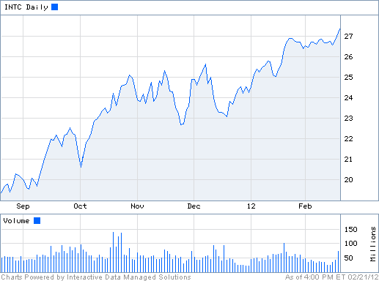
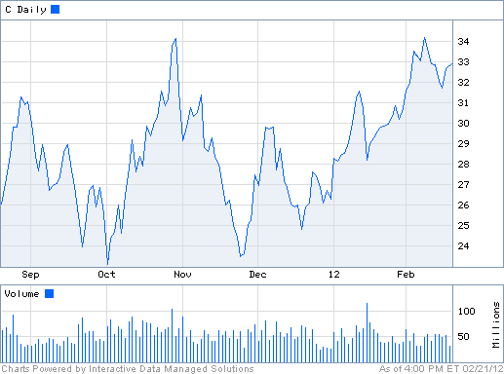
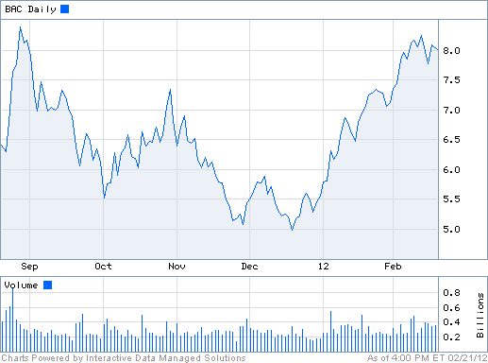
What can you do with the data?
Suppose you are a stock broker and you observe the fluctuations of multiple stocks over time. What information would you like to get out of your data?
Clustering of stocks
Correlation of stocks
Stock Value prediction

Slide 22
What can you do with the data?
You are the owner of a social network, and you have full access to the social graph, what kind of information do you want to get out of your graph?
Who is the most important node in the graph?
What is the shortest path between two nodes?
How many friends two nodes have in common?

Slide 23
Why data mining?
Commercial point of view
Data has become the key competitive advantage of companies
Examples: Facebook, Google, Amazon
Being able to extract useful information out of the data is key for exploiting them commercially.
Scientific point of view
Scientists are at an unprecedented position where they can collect TB of information
Examples: Sensor data, astronomy data, social network data, gene data
We need the tools to analyze such data to get a better understanding of the world and advance science
Scale (in data size and feature dimension)
Why not use traditional analytic methods?
Enormity of data, curse of dimensionality
The amount and the complexity of data does not allow for manual processing of the data. We need automated techniques.

Slide 24
What is Data Mining again?
“Data mining is the analysis of (often large) observational data sets to find unsuspected relationships and to summarize the data in novel ways that are both understandable and useful to the data analyst” (Hand, Mannila, Smyth)
“Data mining is the discovery of models for data” (Rajaraman, Ullman)
We can have the following types of models
Models that explain the data (e.g., a single function)
Models that predict the future data instances.
Models that summarize the data
Models that extract the most prominent features of the data.

Slide 25
What can we do with data mining?
Some examples:
Frequent itemsets and Association Rules extraction
Clustering
Classification

Slide 26
Frequent Itemsets and Association Rules
Given a set of records each of which contain some number of items from a given collection;
Identify sets of items (itemsets) occurring frequently together
Produce dependency rules which will predict occurrence of an item based on occurrences of other items.
Itemsets Discovered:
{Milk,Coke}
{Diaper, Milk}
Rules Discovered:
{Milk} --> {Coke}
{Diaper, Milk} --> {Beer}
Tan, M. Steinbach and V. Kumar, Introduction to Data Mining

Slide 27
Frequent Itemsets: Applications
Text mining: finding associated phrases in text
There are lots of documents that contain the phrases “association rules”, “data mining” and “efficient algorithm”
Recommendations:
Users who buy this item often buy this item as well
Users who watched James Bond movies, also watched Jason Bourne movies.
Recommendations make use of item and user similarity

Slide 28
Association Rule Discovery: Application
Supermarket shelf management.
Goal: To identify items that are bought together by sufficiently many customers.
Approach: Process the point-of-sale data collected with barcode scanners to find dependencies among items.
A classic rule --
If a customer buys diaper and milk, then he is very likely to buy beer.
So, don’t be surprised if you find six-packs stacked next to diapers!
Tan, M. Steinbach and V. Kumar, Introduction to Data Mining

Slide 29
Clustering Definition
Given a set of data points, each having a set of attributes, and a similarity measure among them, find clusters such that
Data points in one cluster are more similar to one another.
Data points in separate clusters are less similar to one another.
Similarity Measures?
Euclidean Distance if attributes are continuous.
Other Problem-specific Measures.
Tan, M. Steinbach and V. Kumar, Introduction to Data Mining

Slide 30
Illustrating Clustering
Euclidean Distance Based Clustering in 3-D space.
Intracluster distances
are minimized
Intercluster distances
are maximized
Tan, M. Steinbach and V. Kumar, Introduction to Data Mining

Slide 31
Clustering: Application
Document Clustering:
Goal: To find groups of documents that are similar to each other based on the important terms appearing in them.
Approach: To identify frequently occurring terms in each document. Form a similarity measure based on the frequencies of different terms. Use it to cluster.
Gain: Information Retrieval can utilize the clusters to relate a new document.
Tan, M. Steinbach and V. Kumar, Introduction to Data Mining

Slide 32
Clustering of S&P 500 Stock Data
Observe Stock Movements every day.
Cluster stocks if they change similarly over time.
Tan, M. Steinbach and V. Kumar, Introduction to Data Mining

Slide 33
Classification: Definition
Given a collection of records (training set )
Each record contains a set of attributes, one of the attributes is the class.
Find a model for class attribute as a function of the values of other attributes.
Goal: previously unseen records should be assigned a class as accurately as possible.
A test set is used to determine the accuracy of the model. Usually, the given data set is divided into training and test sets, with training set used to build the model and test set used to validate it.

Slide 34
Classification Example
categorical
categorical
continuous
class
Test
Set
Learn
Classifier
Training
Set
Model
Tan, M. Steinbach and V. Kumar, Introduction to Data Mining

Slide 35
Classification: Application 1
Ad Click Prediction
Goal: Predict if a user that visits a web page will click on a displayed ad. Use it to target users with high click probability.
Approach:
Collect data for users over a period of time and record who clicks and who does not. The {click, no click} information forms the class attribute.
Use the history of the user (web pages browsed, queries issued) as the features.
Learn a classifier model and test on new users.

Slide 36
Classification: Application 2
Fraud Detection
Goal: Predict fraudulent cases in credit card transactions.
Approach:
Use credit card transactions and the information on its account-holder as attributes.
When does a customer buy, what does he buy, how often he pays on time, etc
Label past transactions as fraud or fair transactions. This forms the class attribute.
Learn a model for the class of the transactions.
Use this model to detect fraud by observing credit card transactions on an account.
Tan, M. Steinbach and V. Kumar, Introduction to Data Mining

Slide 37
Link Analysis Ranking
Given a collection of web pages that are linked to each other, rank the pages according to importance (authoritativeness) in the graph
Intuition: A page gains authority if it is linked to by another page.
Application: When retrieving pages, the authoritativeness is factored in the ranking.

Slide 38
Connections of Data Mining with other areas
Draws ideas from machine learning/AI, pattern recognition, statistics, and database systems
Traditional Techniques may be unsuitable due to
Enormity of data
High dimensionality of data
Heterogeneous, distributed nature of data
Emphasis on the use of data
Statistics/ AI
Machine Learning/
Pattern Recognition
Data Mining
Database systems
Tan, M. Steinbach and V. Kumar, Introduction to Data Mining

Slide 39
Data Mining: Confluence of Multiple Disciplines
Database
Technology
Statistics
Machine
Learning
Data Mining
Visualization
Pattern
Recognition
Other
Disciplines
Algorithm

Slide 40
Data Mining: Confluence of Multiple Disciplines
Database
Technology
Statistics
Machine
Learning
Data Mining
Visualization
Pattern
Recognition
Other
Disciplines
Algorithm

Slide 41
The data analysis pipeline
Mining is not the only step in the analysis process
Preprocessing: real data is noisy, incomplete and inconsistent. Data cleaning is required to make sense of the data
Techniques: Sampling, Dimensionality Reduction, Feature selection.
A dirty work, but it is often the most important step for the analysis.
Post-Processing: Make the data actionable and useful to the user
Statistical analysis of importance
Visualization.
Pre- and Post-processing are often data mining tasks as well
Data Preprocessing
Data Mining
Result
Post-processing

Slide 42
Data Quality
Examples of data quality problems:
Noise and outliers
missing values
duplicate data

Slide 43
Sampling
Sampling is the main technique employed for data selection.
It is often used for both the preliminary investigation of the data and the final data analysis.
Sampling is used in data mining because processing the entire set of data of interest is too expensive or time consuming.

Slide 44
Sampling …
The key principle for effective sampling is the following:
using a sample will work almost as well as using the entire data sets, if the sample is representative
A sample is representative if it has approximately the same property (of interest) as the original set of data

Slide 45
Types of Sampling
Simple Random Sampling
There is an equal probability of selecting any particular item
Sampling without replacement
As each item is selected, it is removed from the population
Sampling with replacement
Objects are not removed from the population as they are selected for the sample.
In sampling with replacement, the same object can be picked up more than once
Stratified sampling
Split the data into several partitions; then draw random samples from each partition

Slide 46

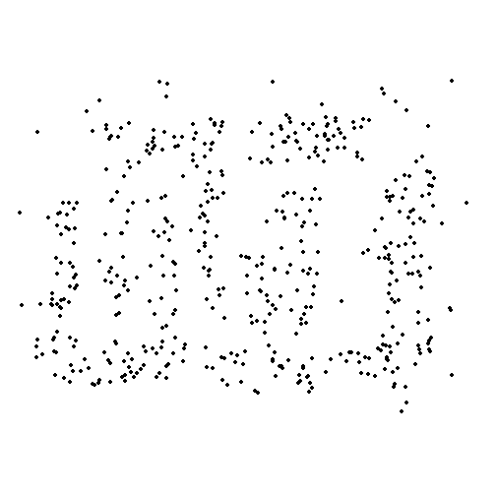
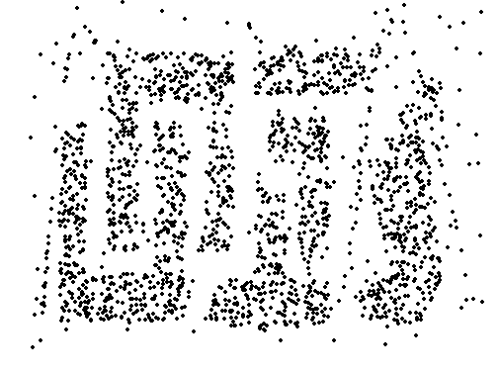
Sample Size
8000 points 2000 Points 500 Points

